Slide 1
Post training optimisation of CNN for image classification on resource constrained devices
BY ZULFIQAR MOHAMMADI SUPERVISOR: DR. XINYU WANG

Slide 2
1.1 INTRODUCTION
Background
Deep learning, especially Convolutional Neural Networks (CNNs), has achieved high accuracy in tasks like image classification.
However, these models are computationally intensive and demand high memory, limiting deployment on devices like:
Mobile phones
Embedded systems
Problem Statement
Lightweight CNNs like MobileNet exist but often sacrifice accuracy for speed and memory efficiency.
Retraining-based optimizations are resource-heavy and impractical for many developers.
Key challenge: ➤ How to reduce model size and inference cost without retraining, while maintaining accuracy?

Slide 3
1.2 MOTIVATION
To make AI more accessible and efficient on resource-constrained environments (RCEs).
Practical relevance for mobile healthcare, IoT, and embedded vision.
Interest in machine learning and building scalable, real-world AI solutions.
Research Focus
Investigate post-training quantization as an efficient solution.
Converts 32-bit floats to 8-bit integers
Minimizes accuracy loss
Reduces model size, energy use, and latency
Benchmarking on MobileNet and other lightweight CNNs.

Slide 4
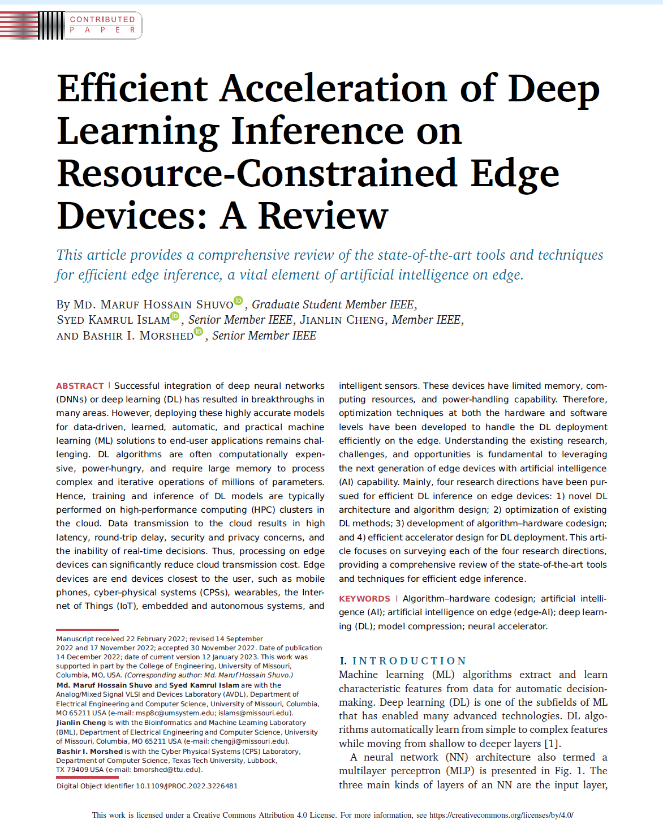
LITERATURE 1
Scope and Contributions
Quantization selection
Comparing quantization approaches
Challenges

Slide 5
2.1.1 Scope and Contributions
Early works focused on reducing cloud dependency.
Used quantization, pruning, and hardware-aware architectures.
Problems: retraining and full dataset access needed.
Our focus: Post-Training Quantization (PTQ).
PTQ allows smaller, faster models without retraining.
Supports real-world on-device deployment with pre-trained models.

Slide 6
2.1.2 Quantization Selection
Quantization reduces bit-width: FP32 → INT8 or FP16.
Improves speed, power use, and model size.
Maintains accuracy with efficient computation.
Trade-off: Accuracy loss in sensitive layers.

Slide 7
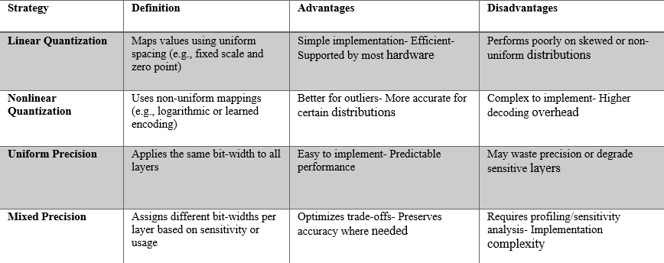
2.1.3 Comparing Quantization Approaches
Linear: Simple, hardware-friendly; struggles with skewed data.
Nonlinear: Better for outliers; complex decoding.
Uniform: Fixed step size; less adaptable.
Mixed Precision: Balances speed and accuracy; hard to tune.
Our choice: Linear Quantization + Mixed Precision for edge compatibility.
Figure 1 provides detailed discussion about these approaches
Figure 1: Quantization strategy summary

Slide 8
2.1.4 Challenges and Research Gap
Quantization can degrade accuracy in deep CNNs (e.g., ResNet).
Best quantization technique per architecture still unclear.
Our research: Evaluate quantization sensitivity per model.

Slide 9
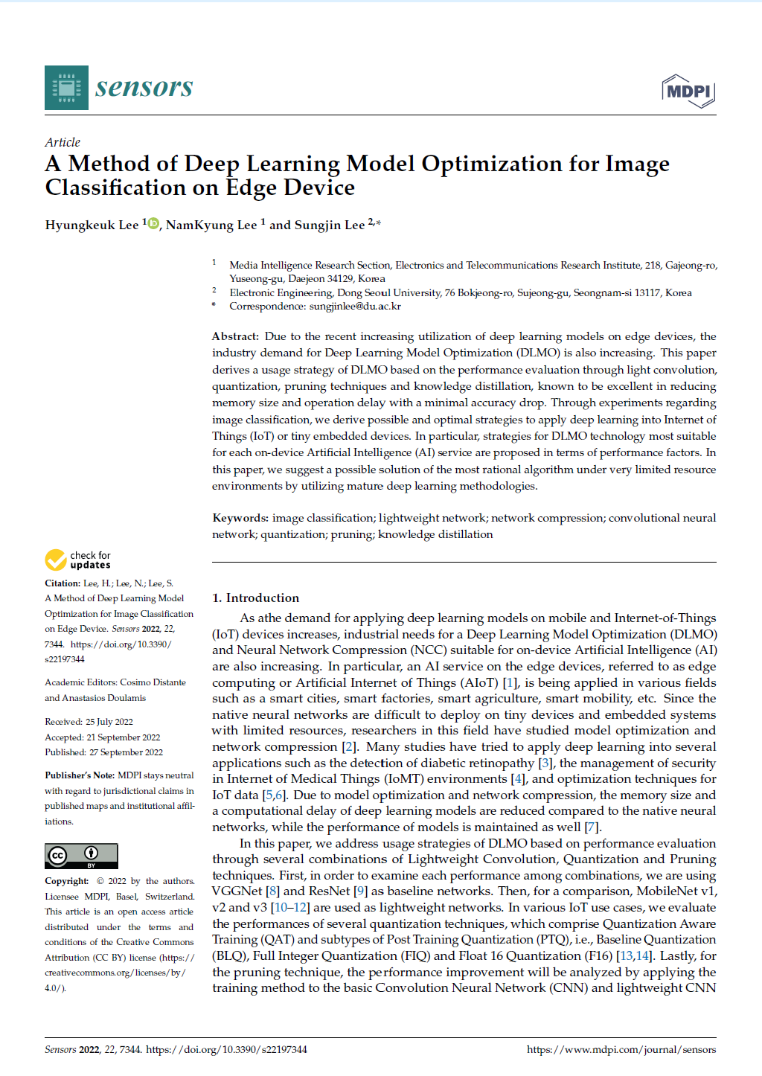
LITERATURE 2
Scope and Contributions
Quantization selection
Comparing quantization approaches
Challenges

Slide 10
2.2.1 Project Scope
Evaluate quantization methods: DRQ, FIQ, and FP16.
Tested on CNN models: EfficientNetB0, MobileNetV2, MobileNet.
Dataset: CIFAR-100.
Focus: Trade-offs between inference speed, accuracy and compression.

Slide 11
2.2.2 Dynamic Range Quantization (DRQ)
Simplest form of post-training quantization.
Weights → statically quantized to INT8.
Activations → dynamically quantized at inference.
Stored in FP32, converted to INT8 during processing.
Easy to apply but limited performance gain.

Slide 12
2.2.3 Full Integer Quantization (FIQ)
Quantizes weights, activations, and biases to INT8.
Requires calibration data.
Supports full integer inference.
Best for hardware accelerators (e.g., TPUs, GPUs).
High efficiency but accuracy drop possible.

Slide 13
2.2.4 FP16 Quantization
Reduces slight precision but retains float structure.
Easy to implement; good accuracy retention.
Compatible with modern GPUs.
Lower compression.

Slide 14
2.2.5 Summary of Findings
Figure 2 shows detailed comparison of DRQ, FIQ and FP16
FIQ: Best compression and speed; needs calibration.
FP16: High accuracy, simple to use.
DRQ: Easiest to apply; limited improvement.
Figure 2: Quantization methods Summary

Slide 15
2.3 Summary and Critical Insights from Literature review
Quantization is lightweight and effective.
Every technique has trade-offs in size, speed, and accuracy.
No universal solution fits all cases.
Our research focuses on Post-training quantization only.

Slide 16
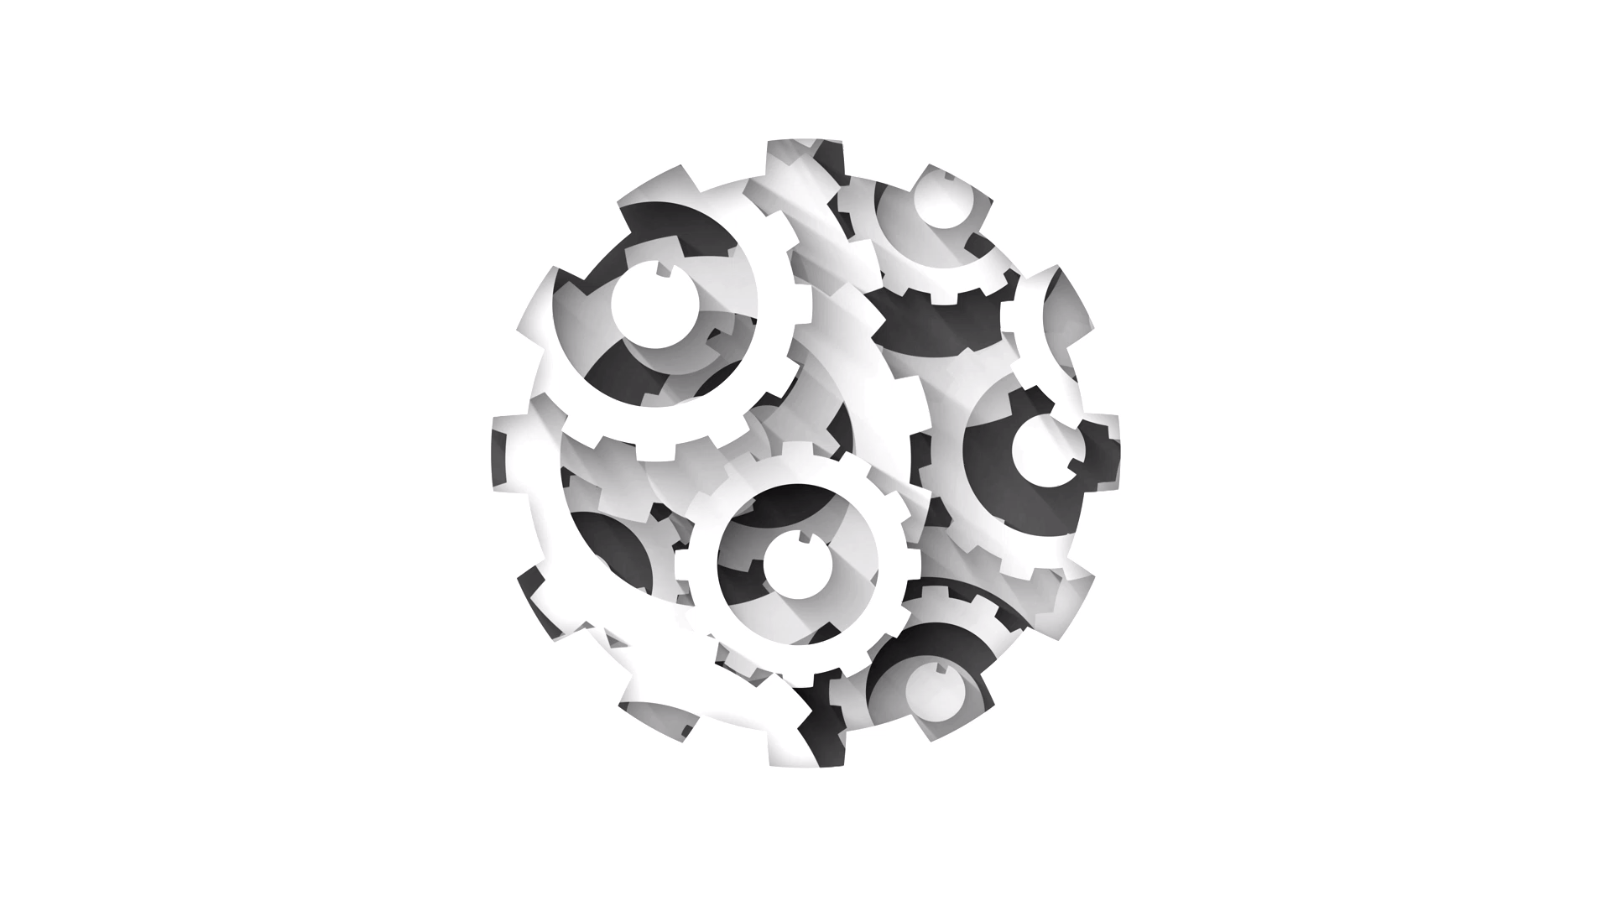
3. METHODOLOGY

Slide 17

3.1 Dataset & Preprocessing
Dataset: CIFAR-100 (60,000 images, 32×32 pixels, 100 classes)
Split: 50,000 train / 10,000 test
Images resized to 224×224 for model compatibility
Preprocessing via keras.applications functions
Labels converted to one-hot encoding

Slide 18
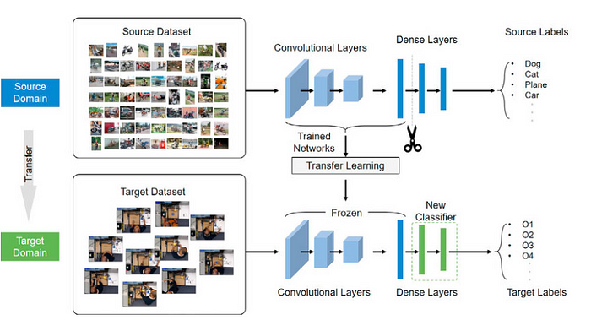
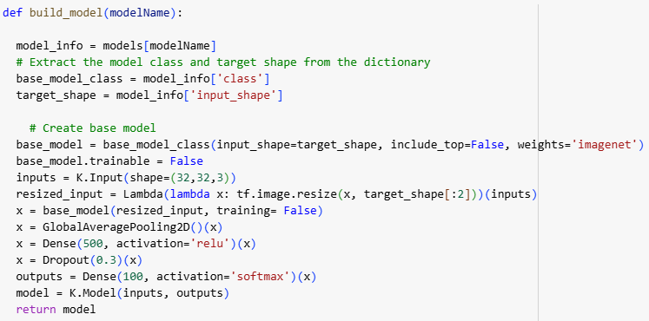
3.2 Model Setup
Used pre-trained models:
EfficientNetB0,
MobileNetV2
Feature extraction with custom classification head (demonstrated in Figure 3):
Global Average Pooling
Dense(500, ReLU) → Dropout → Dense(100, SoftMax)
Figure 3: Model Convolution layers with custom Top Layers
Figure 4: Build model Python code

Slide 19
3.3 Training Configuration
Trained one model at a time due to limited resources
Epochs: 5, Batch Size: 300
Optimizer: Adam, Learning Rate: 0.0005
Evaluation metrics (Shown in Figure 5)
Evaluation metrics
Accuracy and Loss (Train/Test)
Inference time
Parameters count
Model size
Figure 5: Evaluation metrics

Slide 20
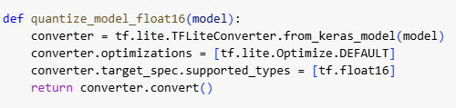
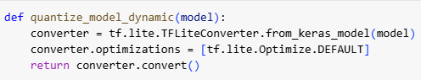
3.4 Quantization Techniques
Dynamic Range Quantization (DRQ)
Weights → int8
Figure 6 represents the DRQ python code
Float16 Quantization
Weights → float16
Figure 7 represents the FP16 python code
Figure 6: Python code DRQ
Figure 7: Python code FP16

Slide 21
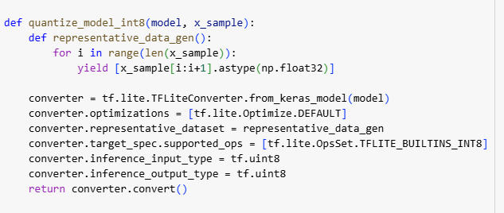
Quantization Techniques
Full Integer Quantization (INT8):
Weights & Activations → int8 Requires calibration with a representative dataset
Figure 8 represents the INT8 python code
Figure 8: Python code INT8

Slide 22
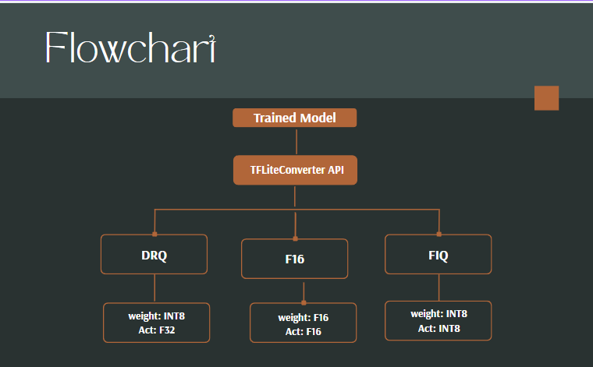
3.5 Quantization Process (shown in Fig 9)
Convert trained model with TFLiteConverter
Apply tf.lite.Optimize.DEFAULT
Calibrate INT8 with sample data
Set precision and export as .tflite file
Figure 9: Quantization Diagram (Canva)

Slide 23
3.6 Evaluation of Quantized Models
Figure 10 represents the evaluation metrics of quantized models
Accuracy on test data
Inference time per image
Model size (in MB)
Visualized using comparison graphs (accuracy, speed, size)
Evaluation metrics
Accuracy
Inference time
Model size
Tools & Environment
Python, TensorFlow, Keras, NumPy, Matplotlib, Excel
Execution platforms: Google Colab & Local Machine
Figure 10: Evaluation metrics of quantized models

Slide 24
4. Experimental Setup
Image classification experiments conducted on CIFAR-100 dataset.
Used multiple Keras models with automated training via dictionary setup.
Metrics: accuracy, loss, parameters, inference time, model size.
Compare original vs quantized models (DRQ, FP16, INT8).

Slide 25
4.1 Evaluation Methodology
Model Training (Figure 11)
Train/test accuracy and loss
Number of parameters
Inference/training time per sample
Model size (MB)
Quantization (Figure 10)
Accuracy drop
Latency in ms
Compression efficiency
Evaluation metrics
Accuracy
Inference time
Model size
Evaluation metrics
Accuracy and Loss (Train/Test)
Inference time
Parameters count
Model size
Figure 11: Evaluation metrics of model training
Figure 10: Evaluation metrics of quantized models

Slide 26
4.2 Hardware & Execution Constraints
Limited computational resources.
Models trained one at a time.
Results stored in separate CSVs, merged post-experiment.
Inference timing averaged over 300 batches, 5 epochs.
Hardware:
CPU: AMD Ryzen 7 7730U
RAM: 16 GB
GPU: Google Collab T4 (Free version)
Batch size: 300

Slide 27
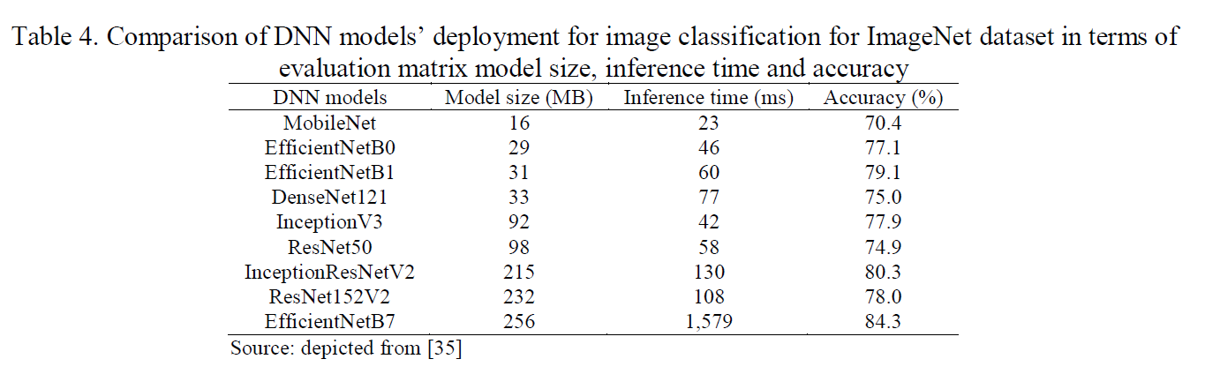
4.3 Model Selection for Quantization
Selection based on size, speed, and accuracy (shown in Figure 12).
Top 3 suitable for edge deployment:
MobileNet & MobileNetV2
EfficientNetB0
Due to time/resource constraints, quantization limited to these models.
Figure 12: Comparison table (Careem, Johar and Khatibi, 2024)

Slide 28
5. RESULTS
EfficientNetB0 achieves the highest test accuracy (72%) and lowest loss (0.94), showing best generalization.
MobileNetV2 is the most lightweight (2.94M parameters, 16.87 MB), suited for memory-constrained environments.
EfficientNetB0 delivers fastest inference (20.52s/sample), critical for real-time applications.
MobileNetV2 offers fastest training time (334.69s).
Choose MobileNetV2 for efficiency.
Figure 13 represents the Experiment results before quantization
Model | Test Accuracy | Test Loss | Parameters (M) | Training Time (s) | Inference Time (s/sample) | Model Size (MB)
MobileNet | 0.66 | 1.13 | 3.80 | 372.53 | 4.27 | 18.95
MobileNetV2 | 0.63 | 1.24 | 2.94 | 334.69 | 7.6 | 16.87
EfficientNetB0 | 0.72 | 0.94 | 4.7 | 423.58 | 20.52 | 23.81
Figure 13: Experiment results before quantization

Slide 29
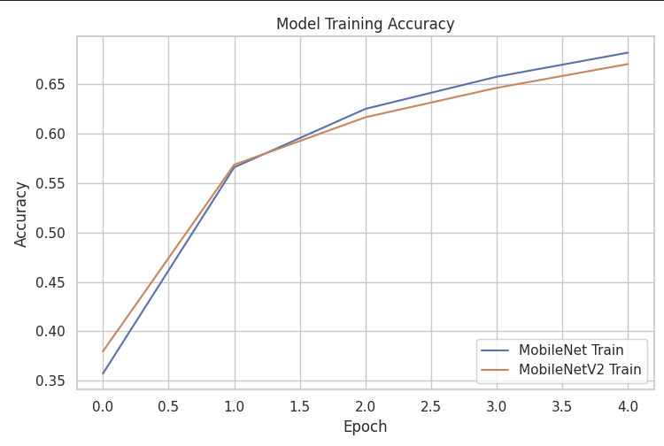
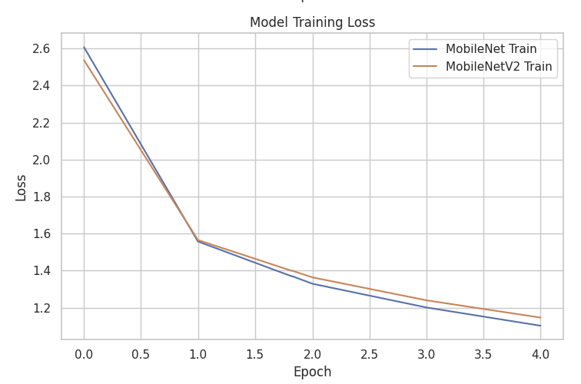
5. RESULTS
Model Training accuracy and loss (Figure 14 & 15)
Both MobileNet and MobileNetV2 show consistent improvement during training.
MobileNet outperforms MobileNetV2 in training accuracy across all epochs post second epoch.
MobileNet reached 68% training accuracy by epoch 5, while MobileNetV2 reached 66%.
MobileNet reached nearly 1.1% training loss by epoch 5, while MobileNetV2 reached just under 1.2%.
Figure 14: MobileNet and MobileNetV2 Training Accuracy
Figure 15: MobileNet and MobileNetV2 Training Loss

Slide 30
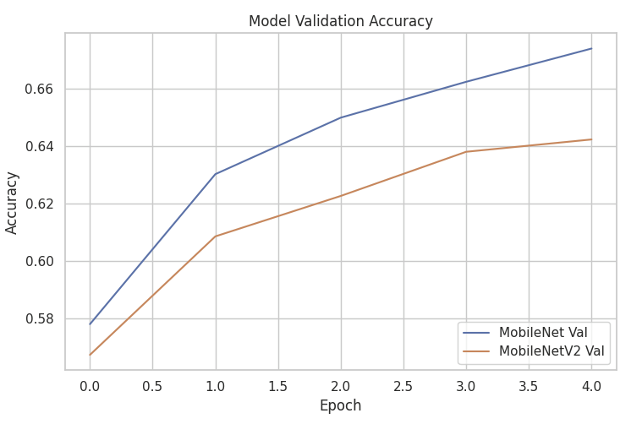
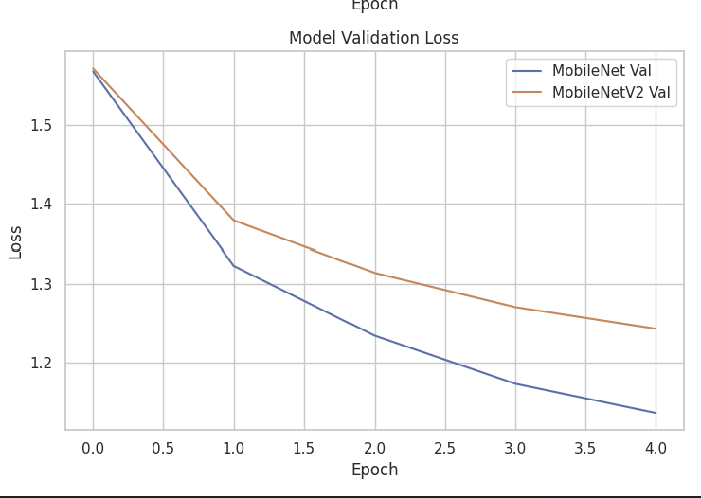
5. RESULTS
Model validation accuracy and loss (Figure 16 & 17)
Results suggest MobileNet generalizes better and learns more efficiently in the early training phase.
MobileNet reached 68% validation accuracy by epoch 5, while MobileNetV2 reached just above 64%.
Figure 16: MobileNet and MobileNetV2 validation accuracy
Figure 17: MobileNet and MobileNetV2 validation Loss

Slide 31
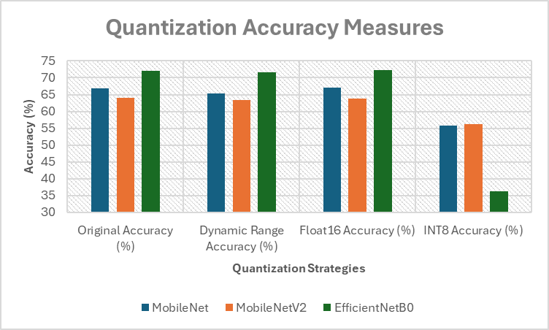
5. RESULTS
Comparison with original model (Table 1 & Figure 18)
Less than 1% accuracy drop in DRQ
slight improvement in F16
Significant drop in INT8
Deeper Models lose accuracy significantly with INT8 due to precision in floating points (Careem, Johar and Khatibi, 2024)
Slight improvement in FP16 due to Hardware optimization or regularization effect (Careem, Johar and Khatibi, 2024)
 | Original Accuracy (%) | Dynamic Range Accuracy (%) | Float16 Accuracy (%) | INT8 Accuracy (%)
MobileNet | 66.92 | 65.33 | 66.99 | 55.7
MobileNetV2 | 63.96 | 63.43 | 63.89 | 56.23
EfficientNetB0 | 72.15 | 71.58 | 72.23 | 36.29
Table 1: Quantization Accuracy Measures
Figure 18: Quantization Accuracy Measures

Slide 32
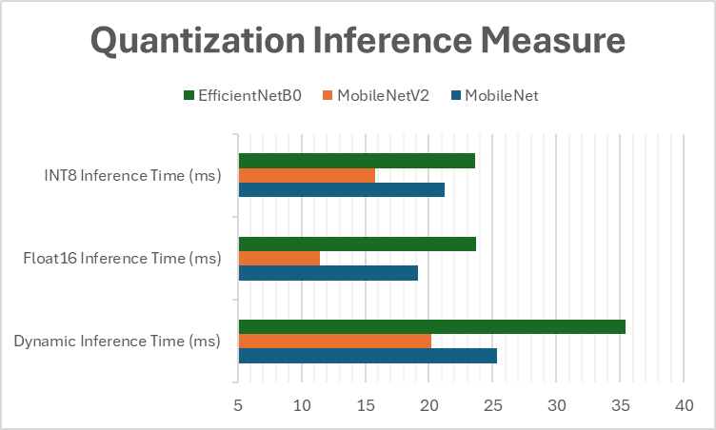
RESULTS
Figure 19 and Table 2 represents the comparison of inference time per sample of the quantized models
DRQ not ideal for improving inference time
F16 provides best result for inference time improvement
MobileNetV2 quantized with F16 provides the lowest inference time.
 | Dynamic Inference Time (ms) | Float16 Inference Time (ms) | INT8 Inference Time (ms)
MobileNet | 25.36 | 19.13 | 21.27
MobileNetV2 | 20.2 | 11.46 | 15.82
EfficientNetB0 | 35.45 | 23.68 | 23.6
Table 2: Quantization Inference Measures
Figure 19: Quantization Inference Measures

Slide 33
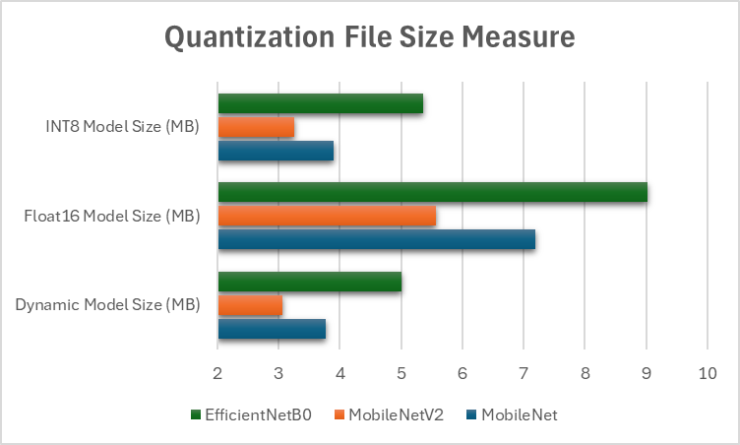
5. RESULTS
Figure 20 and Table 3 represents the comparison of file size of the quantized models
F16 not ideal for compression
INT8 reduced model size by (4x)
MobileNetV2 had the lowest model size
 | Dynamic Model Size (MB) | Float16 Model Size (MB) | INT8 Model Size (MB)
MobileNet | 3.77 | 7.19 | 3.9
MobileNetV2 | 3.06 | 5.57 | 3.26
EfficientNetB0 | 5 | 9.02 | 5.36
Table 3: Quantization File Size Measures
Figure 20: Quantization File Size Measures

Slide 34
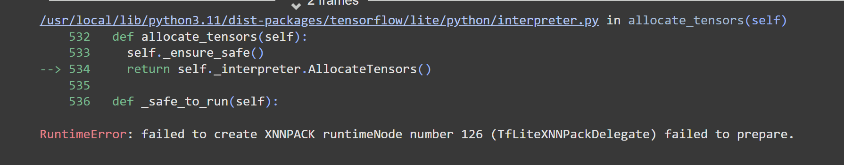
6. DISCUSSION AND CHALLENGES
6.1 Resource Constraints
Long training/quantization time (~40 mins/model) led to manual sequential workflow.
Slowed result collection and analysis.
Future: Use cloud GPU/TPU (e.g. Google Cloud, AWS) or apply early stopping, checkpointing.
6.2 XNNPack Compatibility Error (Figure 20)
MobileNetV3-Small/Large failed INT8 quantization with XNNPack.
Caused fallback to slower CPU-only execution.
Future: Check TensorFlow Lite compatibility docs before selecting models/quant methods.
Check quantization compatibility with PyTorch.
6.3 Input Normalization Errors:
Used 0–1 scaling instead of required -1–1 for models.
Caused large drop in accuracy (e.g., 44%).
Resolved by using Keras-specific preprocessing functions.
Future: Integrate model-specific preprocessing early in data pipeline.
Figure 20: Snapshot of XNNPack Error

Slide 35
7. GitHub Repository
You can find the training process and results in the Jupyter Notebook available in the provided GitHub repository.
https://github.com/Zulfi12345/Machine-Learning-Project.git

Slide 36
8. CONCLUSION
Evaluated MobileNet, MobileNetV2, and EfficientNetB0 on CIFAR-100.
Applied Dynamic Range, Float16, and INT8 post-training quantization.
EfficientNetB0 had highest original accuracy (72.15%).
MobileNetV2 was most efficient post-quantization.
Float16 preserved accuracy and improved speed — best for real-time use.
INT8 offered best compression but hurt accuracy, especially in complex models.
Future Work (If I had another six months):
Train models for more epochs using early stopping to improve generalization.
Fine-tune quantized models to recover performance.
Resolve XNNPack issues for MobileNetV3-Small/Large with INT8 quantization.

Slide 37
REFRENCES
Shuvo, M.M.H., Islam, S.K., Cheng, J. and Morshed, B.I., 2022. Efficient acceleration of deep learning inference on resource-constrained edge devices: A review. Proceedings of the IEEE, 111(1), pp.42-91.
Careem, R., Johar, G. and Khatibi, A., 2024. Deep neural networks optimization for resource-constrained environments: techniques and models. Indonesian Journal of Electrical Engineering and Computer Science, 33(3), pp.1843-1854.
Lee, H., Lee, N. and Lee, S., 2022. A method of deep learning model optimization for image classification on edge device. Sensors, 22(19), p.7344.
Yuan, H., Cheng, J., Wu, Y. and Zeng, Z., 2022. Low-res MobileNet: An efficient lightweight network for low-resolution image classification in resource-constrained scenarios. Multimedia Tools and Applications, 81(27), pp.38513-38530.
Debasish Kalita, 2025 Basics of CNN in Deep Learning. Analytics Vidhya.
codebasics (2021). Quantization in deep learning | Deep Learning Tutorial 49 (Tensorflow, Keras & Python). [online] YouTube. Available at: https://www.youtube.com/watch?v=v1oHf1KV6kM [Accessed 14 Apr. 2025].
Team, K. (n.d.). Keras documentation: Keras Applications. [online] keras.io. Available at: https://keras.io/api/applications/.
‌TensorFlow. (n.d.). Transfer learning with a pretrained ConvNet | TensorFlow Core. [online] Available at: https://www.tensorflow.org/tutorials/images/transfer_learning.
‌Kulkarni, U., Meena, S.M., Gurlahosur, S.V. and Bhogar, G., 2021. Quantization friendly mobilenet (qf-mobilenet) architecture for vision based applications on embedded platforms. Neural Networks, 136, pp.28-39.
Chung, C.C., Chen, W.T. and Chang, Y.C., 2020, February. Using quantization-aware training technique with post-training fine-tuning quantization to implement a MOBILENET hardware accelerator. In 2020 Indo–Taiwan 2nd International Conference on Computing, Analytics and Networks (Indo-Taiwan ICAN) (pp. 28-32). IEEE.
Kluska, P. and Zięba, M., 2020. Post-training quantization methods for deep learning models. In Intelligent Information and Database Systems: 12th Asian Conference, ACIIDS 2020, Phuket, Thailand, March 23–26, 2020, Proceedings, Part I 12 (pp. 467-479). Springer International Publishing.

